Slide 1
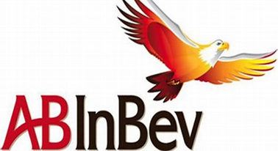
US Beer Market Analysis AB InBev
Fred poon, Data Scientist
Laura Lazarescou, Data Scientist

Slide 2
Introduction
Review AB InBev Goals and Objectives
Data Preparation
Insights and Observations
Recommendations
Q&A

Slide 3
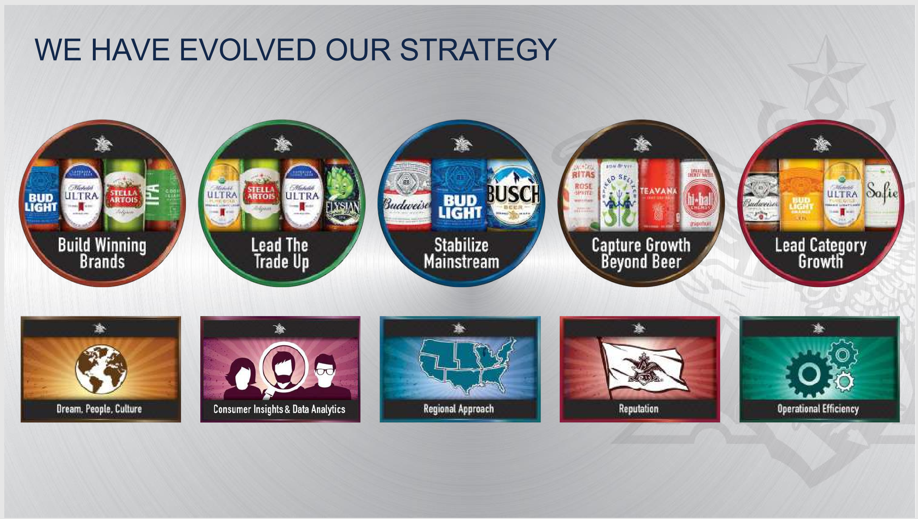

Slide 4
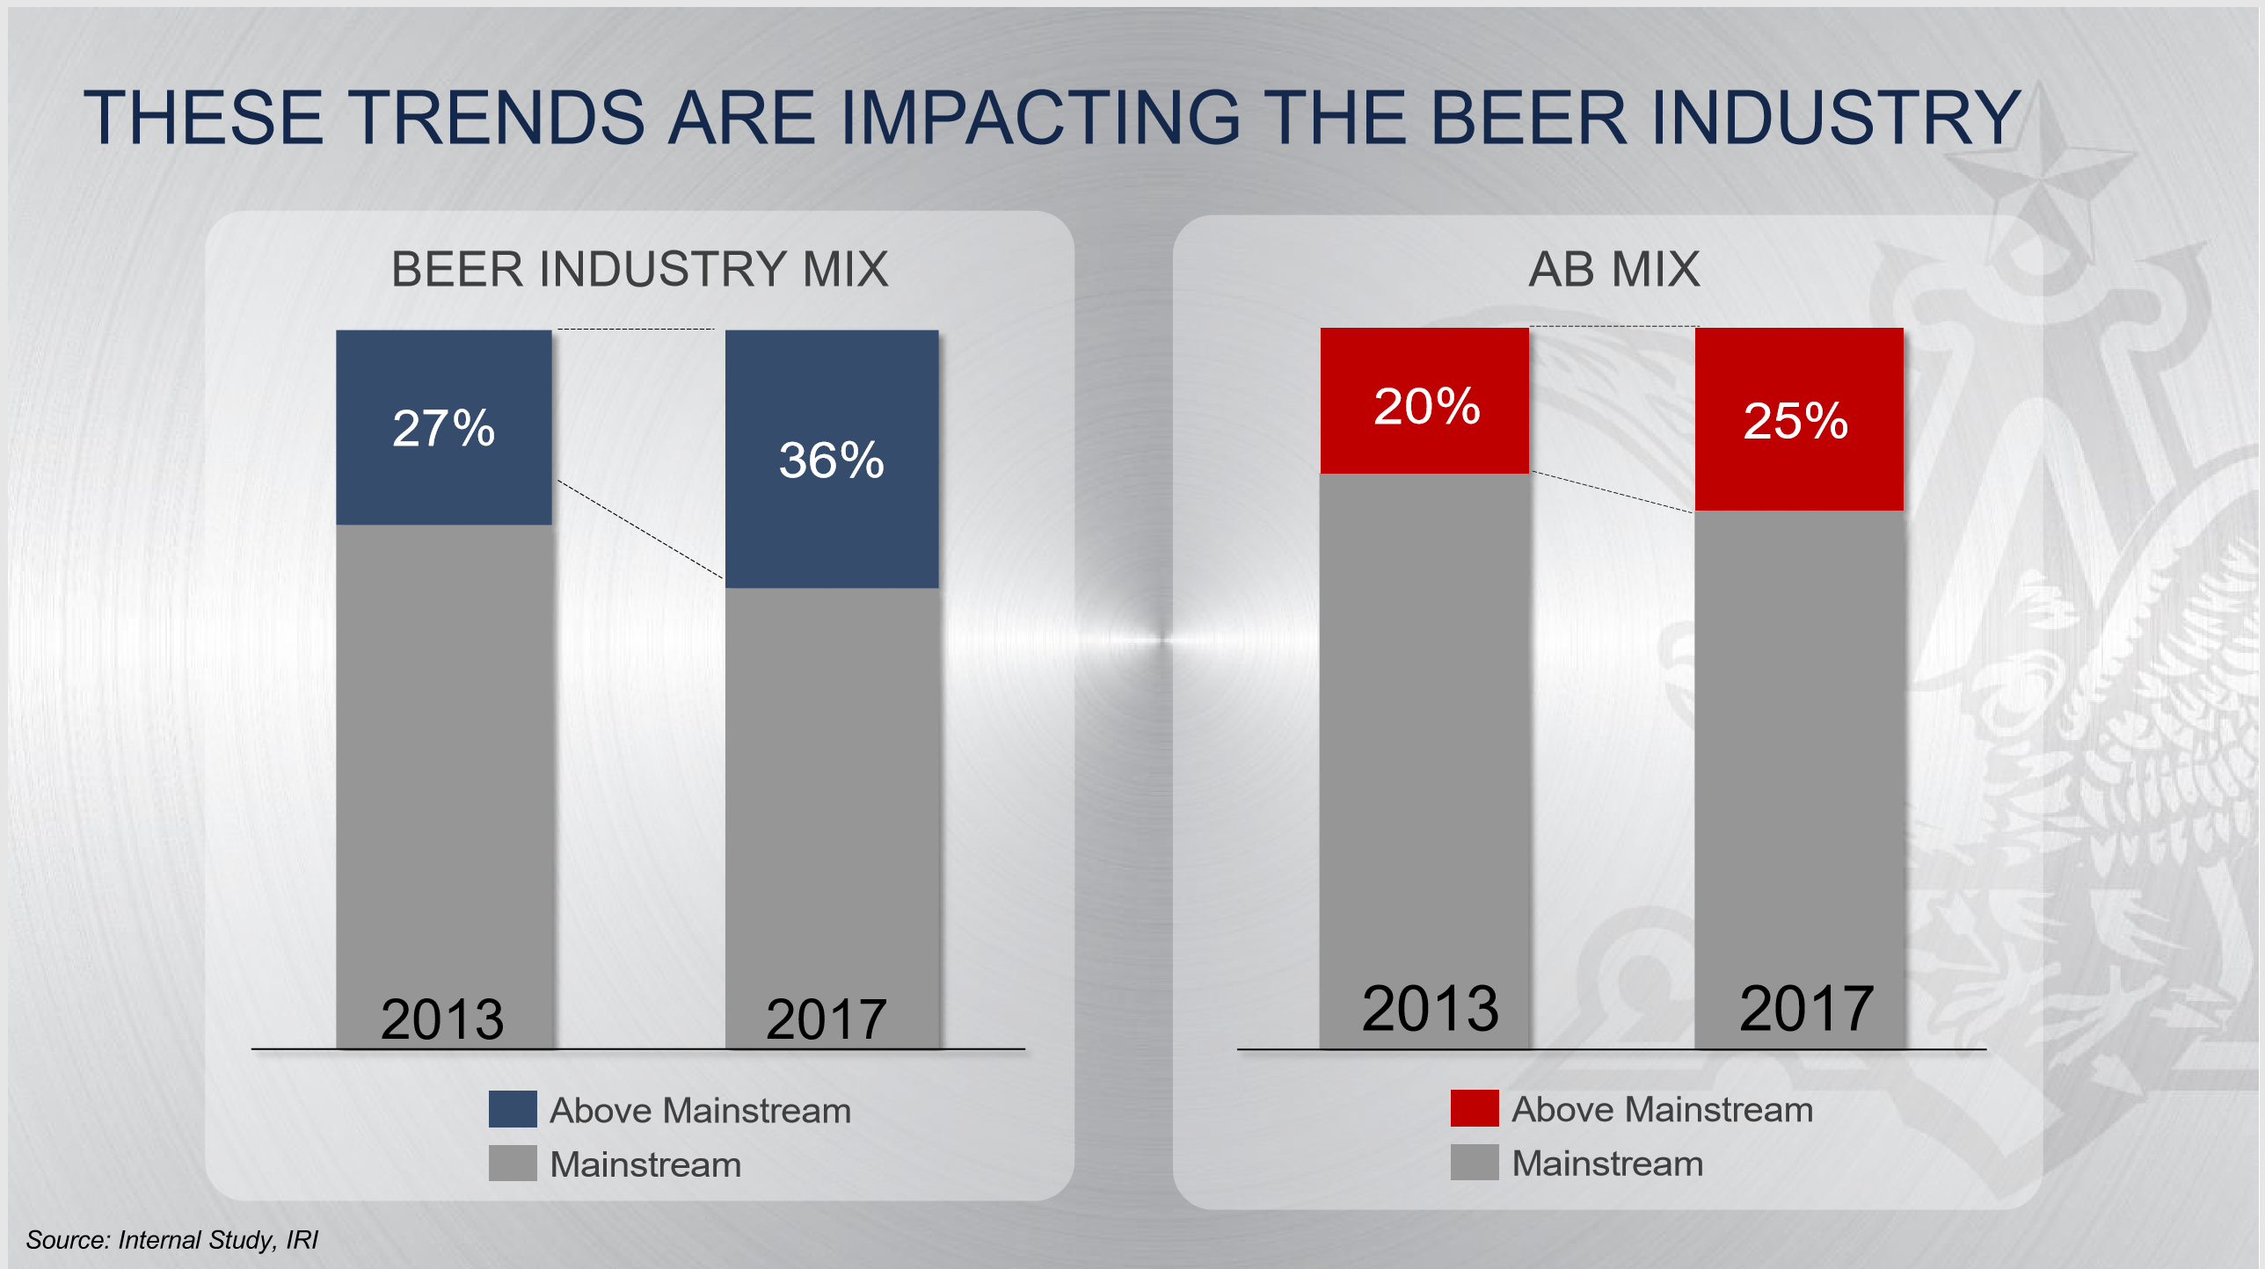

Slide 5
Beer and Brewery Data Analysis
Overall Analysis
2410 Beer and Cider Brands
558 Breweries
51 States including DC
Missing Data Values
No IBU: 1005 of 2410
No ABV: 64 of 2410
Conclusions are valid because IBU is not a significant factor in consumer choice and this is a market study.

Slide 6
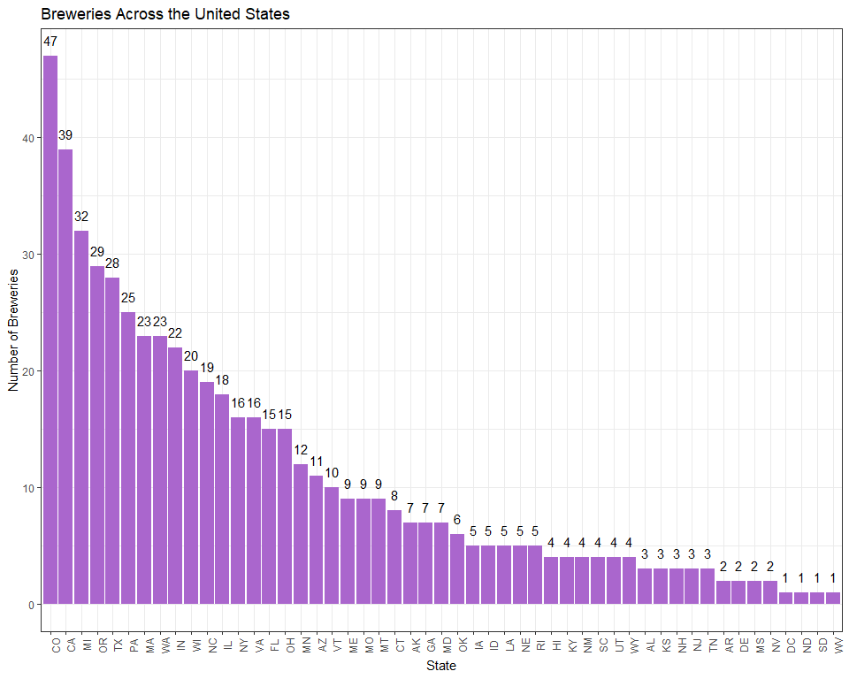
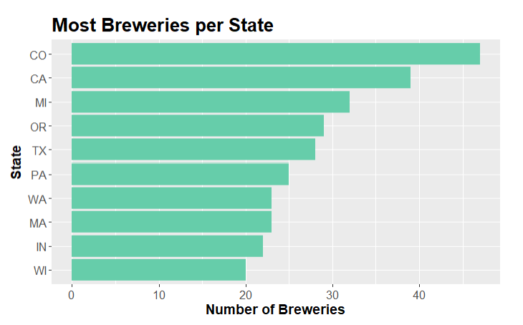
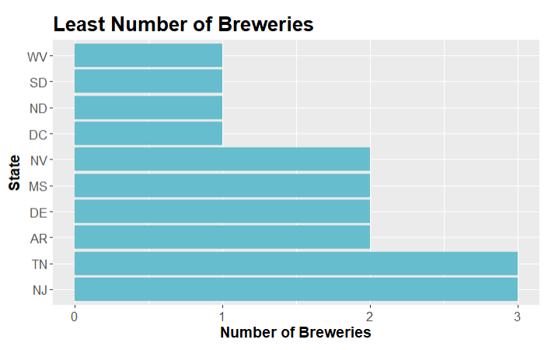
States with Most and Least Breweries
CO 47
CA 39
MI 32
OR 29
TX 28
PA 25
WA 23
MA 23
WV 1
SD 1
ND 1
DC 1
NV 2
MS 2
DE 2
AR 2

Slide 7
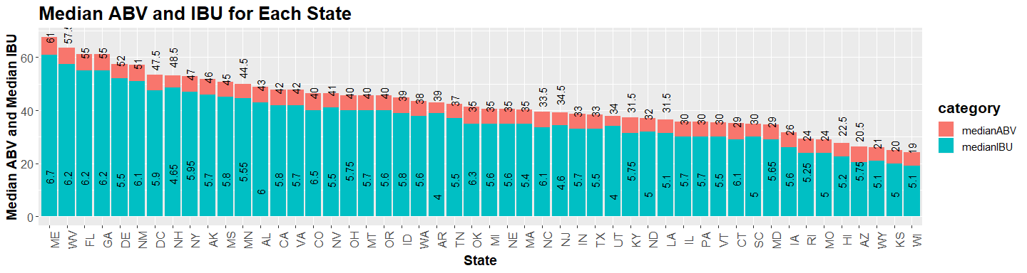
Brewing Preferences: ABV and IBU by State
Median Alcohol % is Consistent
IBU varies by State

Slide 8
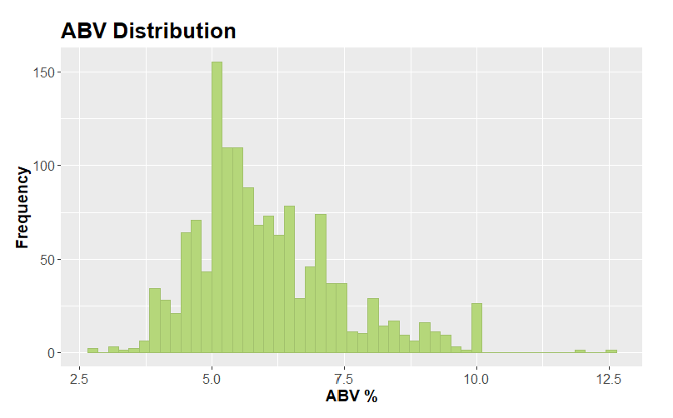
Ideal Alcohol by Volume (ABV) Range: 5% - 7.5%

Slide 9
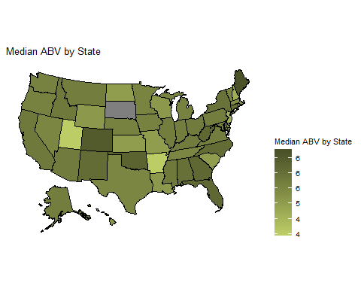
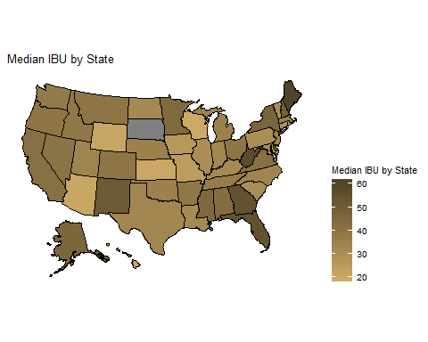
Median Alcohol by Volume (ABV) and Bitterness (IBU) Vary by State

Slide 10
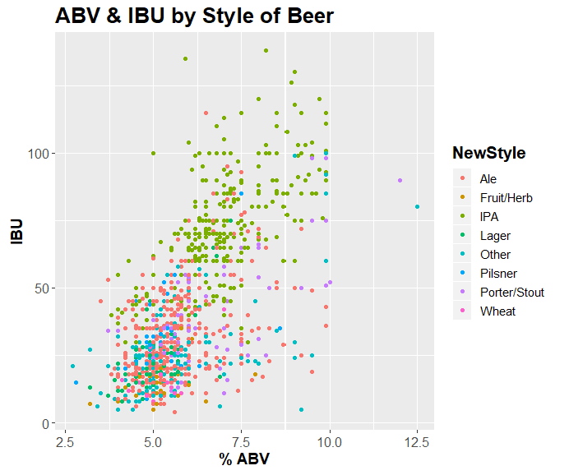
Style and the ABV / IBU relationship
Grouped 100 Individual Styles into 10 Major Styles
Non-IPA Ales are low-IBU, lower ABV
Few Fruit/Herb varieties, but this style is on the rise.

Slide 11
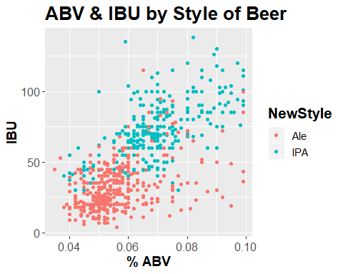
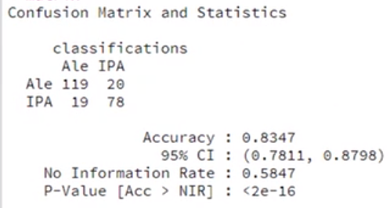
IPA and Ale – Detailed Comparison

Slide 12
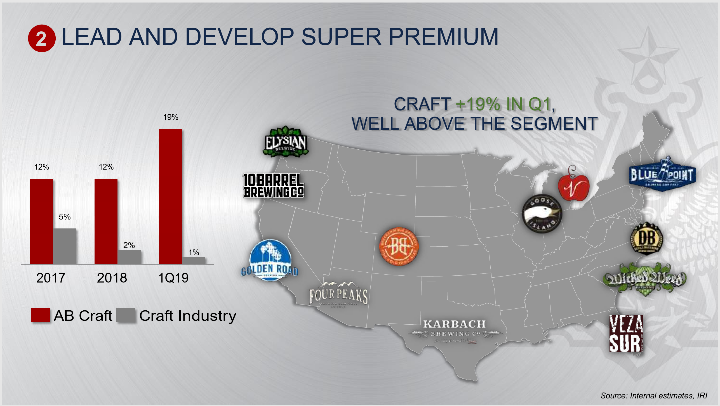
AB InBev Investments and Future Potential

Slide 13
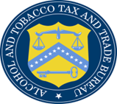
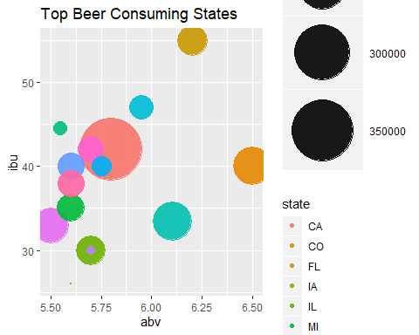
States with Most Beer Consumed (2018 TBB Data)
CA 360,000
NC 181,000
CO 177,000
TX 162,500
FL 139,000
IL 134,000
MI 126,000
OR 122,000
WA 172,000
VA 119,000
NY 112,000
OH 100,000
MN 85,000
PA 78,000
Source: US ALCOHOL AND TOBACCO TAX AND TRADE BUREAU Data compiled from Line 15, Column B (Form TTB 5130.9, Brewer's Report of Operations) + Line 10 (Form TTB 5130.26, Quarterly Brewer's Report of Operations) (formerly Brewpub Report of Operations)

Slide 14
Recommendations
Market Growth is highest for flavored beer and beer alternatives
Craft beer drinkers reject “big beer”– invest vs. acquire
Consumer preference is shifting from IPA to American Pale Ale, Fruit/Herb, Cider and high ABV beers.
Based on AB InBev portfolio and local market consumption, top targets for investment:
NY: Sixpoint Craft Ales
OH: Madtree Brewing Company
MN: Surly Brewing Center
PA: Manayunk Brewing Company

Slide 15
Thank You

